Slide 1
xClarity

Slide 2
What it is
xClarity is a hardware systems management application
Deploy infrastructure faster
Integrates seamlessly with Lenovo
Centralized automated infrastructure deployment
Lifecycle management

Slide 3
Features
Auto-Discovery and Inventory
Firmware updates
Configuration Patterns
Security Management
REST API & Powershell
Email Forwarding

Slide 4
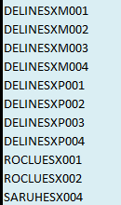
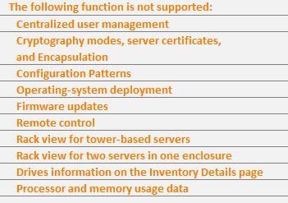




Supported Hardware
For x3650 M5 servers
Full support
For x3650 M4 servers
Partial support

Slide 5
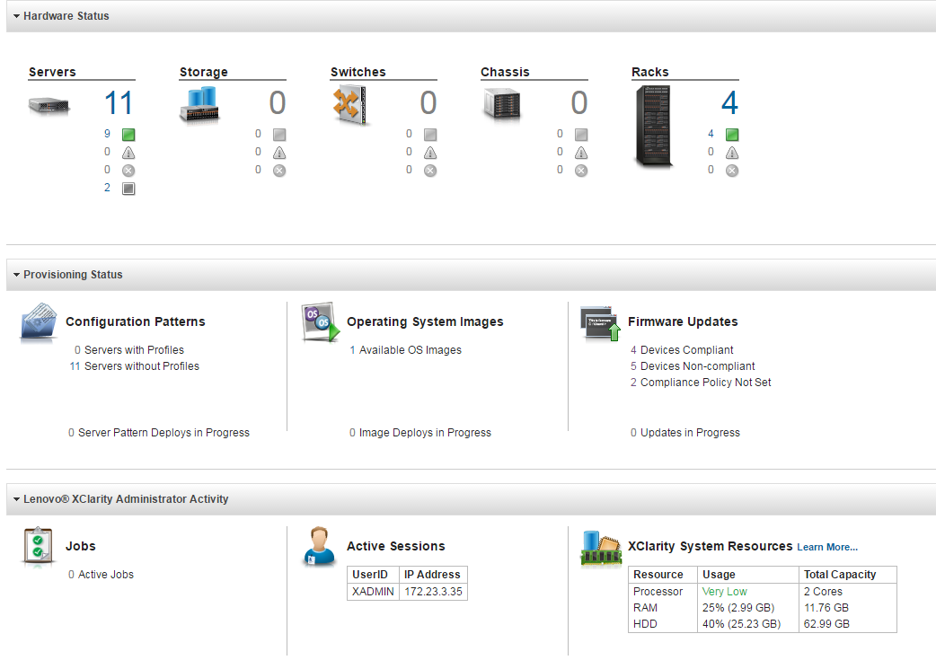

Slide 6
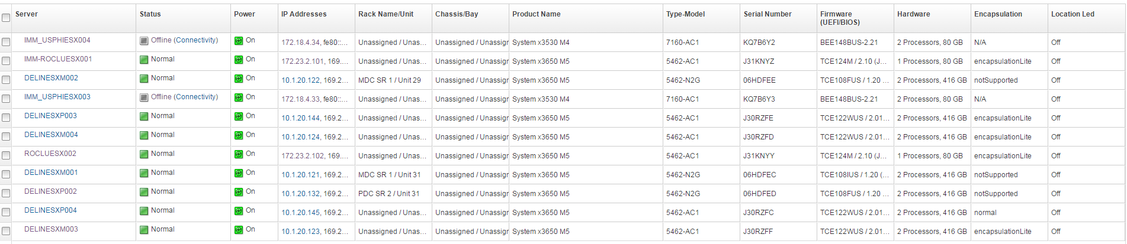

Slide 7
To do
Import all servers
Create patterns
Investigate PowerShell Capabilities
Group servers

